Slide 1
Today
Lecture 14: The Josephson effect --- theory and phenomena
Discussion of the Josephson effect in five parts:
Theory and phenomena
The RSJ model
Magnetic field effects in extended junctions
Fluctuations and quantum tunneling
Beyond tunnel junctions (SNS, microbridges, SFS, …)
Next time
Lecture 15: The Josephson effect --- the RSJ model

Slide 2
Course requirements
The “grade” in this course will be based on two papers to be prepared by each student:
1. The first will be due on October 30, approximately halfway through the course, and cover a topic of your choice on a superconductor material or phenomena.
2. The second will be due at the end of the course on December 10, and will cover a superconductor detector or measurement technique of your choice relevant to quantum materials, quantum sensors, or quantum computing.
Details:
Submit via email as a PDF file
~ 10 pages with figures embedded (standard format: 11pt font, single-spaced, 1” margins, pretty pictures), references
Choose a topic that interests you and is in some relevant to the course.
For graduate research students, the topic can be “relevant” to your thesis research project but should not be your prelim paper (although I would not know that UNLESS I am on your prelim committee)
There is an option to form an N-person team and write a longer paper by x N. One group approached me and wants to do a theory-experiment comparison that seems viable, but in general this may be more appropriate for the second paper. (Realistically, N should probably be no larger than 2).

Slide 3
What are my expectations/suggestions?
You will have to work on finding a good topic --- that is a major part of the assignment and will require you to think, look at literature, gauge how much attention to your topic is out there. That is not easy --- it is a giant field and you want a topic big enough to explore something interesting but small enough to cover.
Think of it as a “review paper” --- it is not original research, but research on what has been done by others and the creation of a summary of that. That is a standard part of the group meetings in my lab. You will need coolect, understand, compile, and present your findings in a clear way --- presentation, as well as content, is important in science.
In the end, I want you to produce something by which:
  You learn something and have fun doing it.
  I learn something, i.e. I can understand what you have learned.
  The class learns something --- I will make the papers available to the class (and maybe even have everyone give a two-slide presentation if we have time).

Slide 4
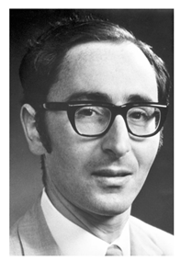
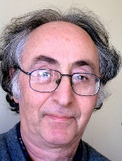
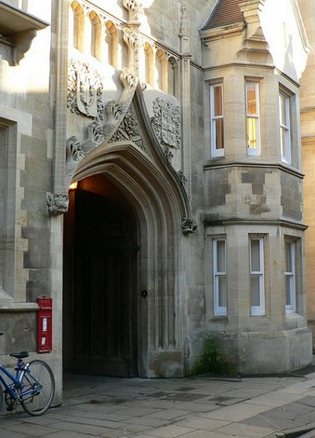
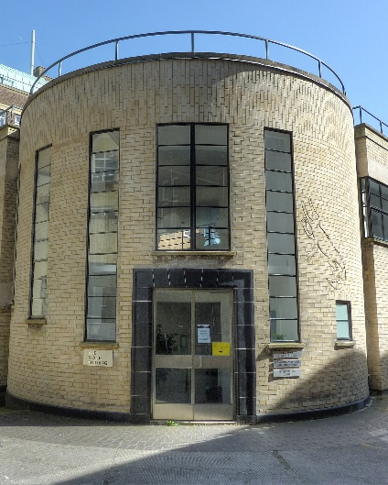
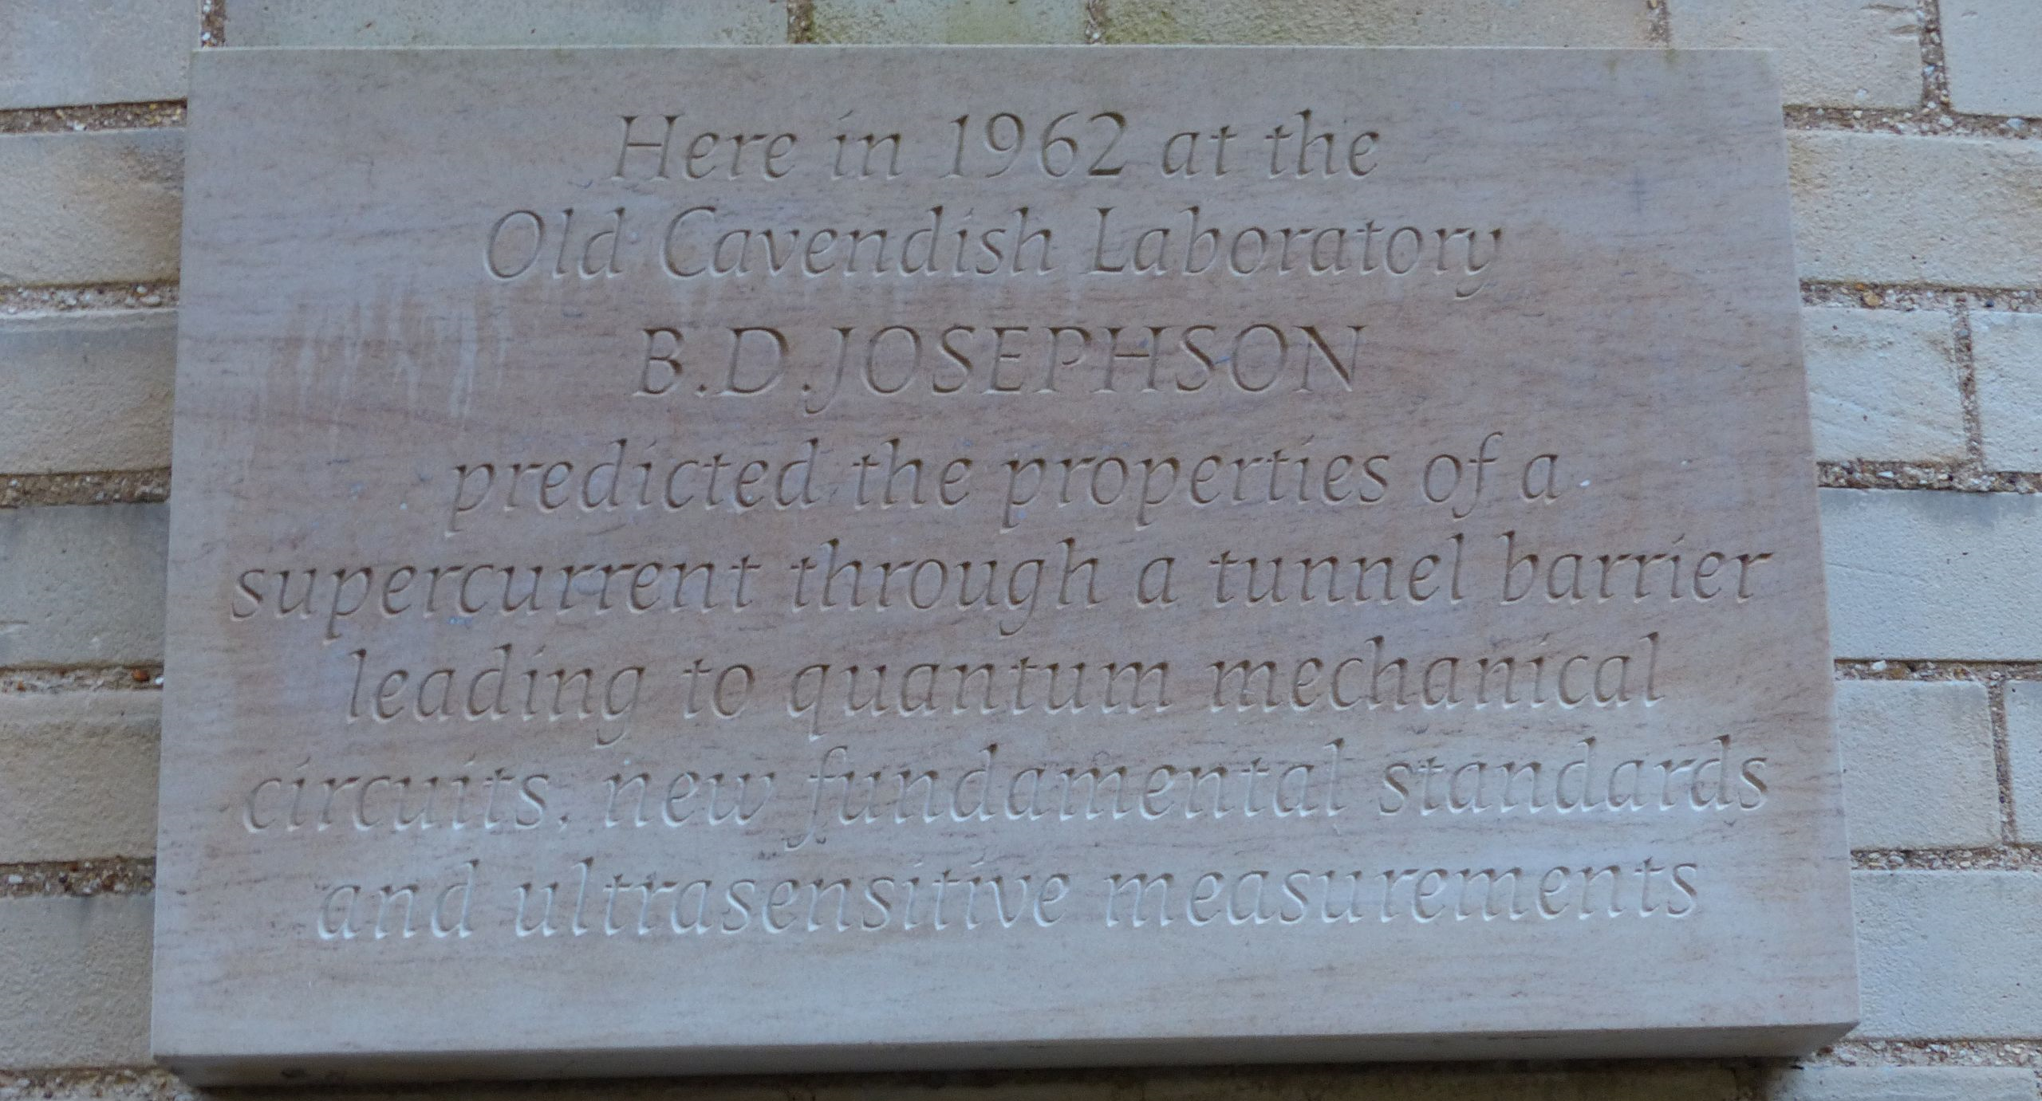
Josephson Effect
Physics Letters 1, 251 (1962)

Slide 5


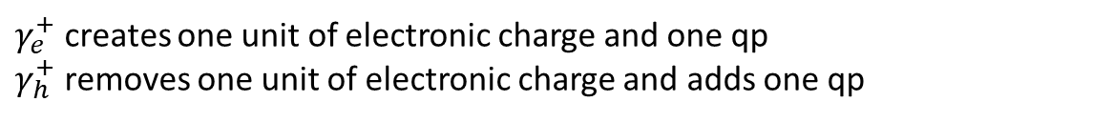



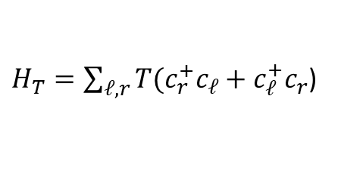


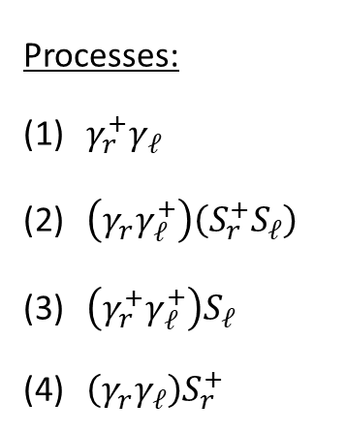

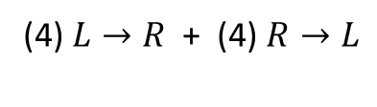


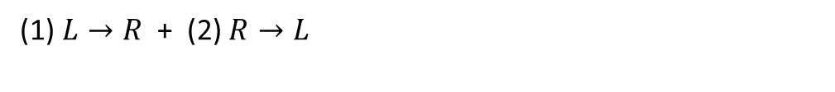



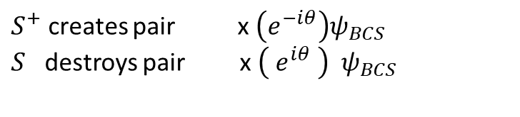


Josephson Effect (1962)
Physics Letters 1, 251 (1962)
Microscopic theory ⟹ not from physical agreement or experiment
$$H=H_{L}+H_{R}+H_{T}$$
$H_{T}=\sum_{ℓ,r}{T(c_{r}^{+}c_{ℓ}+c_{ℓ}^{+}c_{r}}$)
${ c}^{′}s⟶γ_{e}^{′}s, { γ}_{h}^{′}s$ Josephson operators
$${γ_{ek0}}^{+}=u_{k}{c_{k↑}}^{+}−v_{k }S^{+ }c_{−k↓}$$
$γ_{e}^{+}$ creates one unit of electronic charge and one qp
$γ_{h}^{+}$ removes one unit of electronic charge and adds one qp
$${γ_{hk0}}^{+}=u_{k} S{{ c}_{k↑}}^{+}−v_{k}c_{−k↓}$$
$${γ_{ek1}}^{+}=u_{k}c^{+}+v_{k }S^{+}{ c}_{k↑}$$
$S^{+}$ creates pair x $\left(e^{−iθ}\right)ψ_{BCS}$
$S$ destroys pair x $\left({ e}^{iθ} \right){ ψ}_{BCS}$
$${γ_{hk1}}^{+}=u_{k} S{{ c}_{−k↓}}^{+}+v_{k}c_{k↑}$$
Processes:
$γ_{r}^{+}γ_{ℓ}$
$\left(γ_{r}γ_{ℓ}^{+}\right)\left(S_{r}^{+}S_{ℓ}\right)$
$\left(γ_{r}^{+}γ_{ℓ}^{+}\right)S_{ℓ}$
$\left(γ_{r}γ_{ℓ}\right)S_{r}^{+}$
𝐿→𝑅
𝑅→𝐿
Same qp states involved, pair transfer different
$$\left(S_{r}^{+}S_{ℓ}\right)\sim e^{iθ_{r}}e^{−iθ_{ℓ}}=e^{iφ}$$
qp
qp
(1) $L→R$ + (2) $R→L$
qp
qp
$φ=\left(θ_{r}−θ_{ℓ}\right)$
p
p
(2) $L→R$ + (1)$R→L$
$$\left(S_{ℓ}^{+}S_{r}\right)\sim e^{i\left(θ_{ℓ}−θ_{r}\right)}=e^{−iφ}$$
qp
qp
qp
qp
$$\left(S_{r}^{+}S_{ℓ}\right)\sim e^{iθ_{r}}e^{−iθ_{ℓ}}=e^{iφ}$$
p
p
(3) $L→R$ + (3) $R→L$
qp
qp
qp
qp
$$\left(S_{ℓ}^{+}S_{r}\right)\sim e^{i\left(θ_{ℓ}−θ_{r}\right)}=e^{−iφ}$$
p
p
(4) $L→R$ + (4)$R→L$

Slide 6




Cross terms
$$e^{iφ}, e^{−iφ} ⟹ \sin{φ},\cos{φ}$$
$$I\left(V,T,t\right)={σ_{o}\left(V,T\right)V+ I}_{1}\left(V,T\right)\sin{φ\left(t\right)}+σ_{1}(V,T)\cos{φ\left(t\right)V}$$
(1) ${ σ}_{o}V=G_{SS}V=$ qp tunneling (as before)
(2) $I_{1}\sin{φ=}$supercurrent = pair tunneling (current at V=0)
Josephson effects
(3) ${ σ}_{1}V\cos{φ}=$ quasiparticle-pair interference term
      (supercurrent but dissipative)
How did Josephson figure this out?
  Listening to lectures by P. Anderson (lectures on phase transitions)
  2nd order phase transition – broken symmetry
  lower symmetry than the Hamiltonian
$$T>θ$$
$$T<θ$$
“rotational invariance”
Ferromagnet:
Moments random
Moments aligned

Slide 7
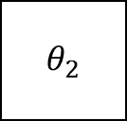
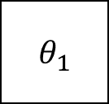

Superconductor: phase (Cooper pairs)
Isolated system: direction (FM) or phase (SC) arbitrary
Coupled systems: domain walls (FM) or interfaces (SC) force a dependence on the phase alignment
SC
SC
Junction properties should depend on $\left(θ_{1}−θ_{2}\right)$
$$θ_{1}$$
$$θ_{2}$$
But then N must be indeterminate
$$\left(∆N ∆θ≳1\right)$$
(BCS)
This suggests that pairs could change sides with energy cost (no dissipation)

Slide 8
This was not believed by many, e.g. John Bardeen
Like multi-particle tunneling, it was thought that the rate should go as ${\left({\left|T\right|}^{2}\right)}^{2}$and be very low probability
Paper that introduces the Josephson operators

Slide 9
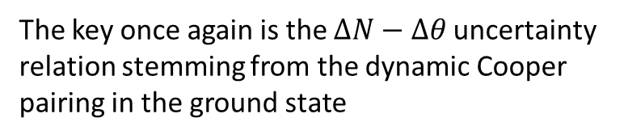
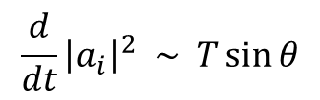
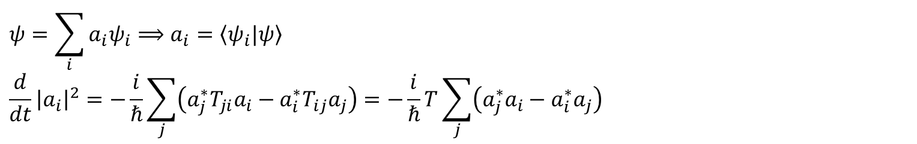
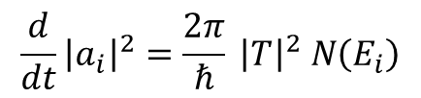
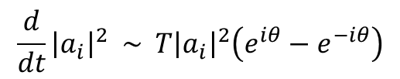
How to understand why this is not true? This is an approach by Waldram to try to make sense of this.
Time-dependent perturbation theory:
$$ψ=\sum_{i}{a_{i}ψ_{i}}⟹a_{i}=\left\langle ψ_{i}|ψ\right\rangle$$
$$\frac{d}{dt}{\left|a_{i}\right|}^{2}=−\frac{i}{ℏ}\sum_{j}{\left(a_{j}^{∗}T_{ji}a_{i}−a_{i}^{∗}T_{ij}a_{j}\right)}=−\frac{i}{ℏ}T\sum_{j}{\left(a_{j}^{∗}a_{i}−a_{i}^{∗}a_{j}\right)}$$
*Usually, the system is near an eigenstate where some $a_{j}=1$ (most probable state)
Then, $a_{i} \sim T$ (perturbation theory) and rate of transition to depend on density of available states ⟹ Golden Rule
$$\frac{d}{dt}{\left|a_{i}\right|}^{2}=\frac{2π}{ℏ} {\left|T\right|}^{2} N\left(E_{i}\right)$$
higher-order transitions
*But, if we consider all $a_{i}≈$ same so just consider two states $i$ and $j$ ${\left|a_{i}\right|}^{2} ≈ {\left|a_{j}\right|}^{2}≈ \frac{1}{2} ⟹{ a}_{i}=a_{j}e^{iθ}$
$$\frac{d}{dt}{\left|a_{i}\right|}^{2} \sim T{\left|a_{i}\right|}^{2}\left(e^{iθ}−e^{−iθ}\right)$$
differ by phase factor only
$$\frac{d}{dt}{\left|a_{i}\right|}^{2} \sim T\sin{θ}$$
The key once again is the $∆N−∆θ$uncertainty relation stemming from the dynamic Cooper pairing in the ground state
depends on just T as in quasiparticle tunneling

Slide 10

Key points:
rates scales as 1st power of matrix elements
correlated 2-step process $\sim {\left|T\right|}^{2}$ so allowable
sinθ comes out naturally
*Josephson current – 2nd order pair tunneling between states mixed in pair occupancy
KEY – fixed phase uncertain ⟹ Josephson tunneling
Pairs don’t know or care which side they are on

Slide 11

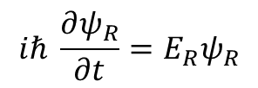
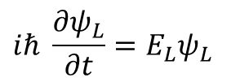

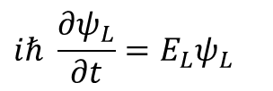

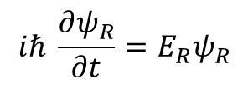




Annother approach:
Feynman treatment – two-level system model due to Rogovin & Scully (1974)
$$ψ_{L}=\sqrt{n_{L}}{ e}^{iθ_{L}}$$
$$ψ_{R}=\sqrt{n_{R}} e^{iθ_{R}}$$
Uncoupled superconductors:
$$iℏ \frac{∂ψ_{L}}{∂t}=E_{L}ψ_{L}$$
$$iℏ \frac{∂ψ_{R}}{∂t}=E_{R}ψ_{R}$$
$$E_{L}−E_{R}=2eV$$
Add tunneling:
$$H=H_{L}+H_{R}+H_{T}$$
$$iℏ \frac{∂ψ_{L}}{∂t}=E_{L}ψ_{L}$$
$$+ Kψ_{R}$$
where
$$K=\left\langle ψ\left|H_{T}\right|ψ\right\rangle$$
is the tunneling rate
$$iℏ \frac{∂ψ_{R}}{∂t}=E_{R}ψ_{R}$$
$+ Kψ_{L}$

Slide 12

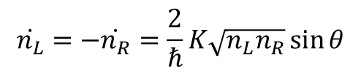
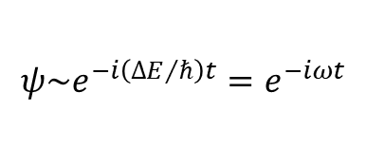


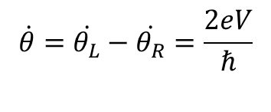


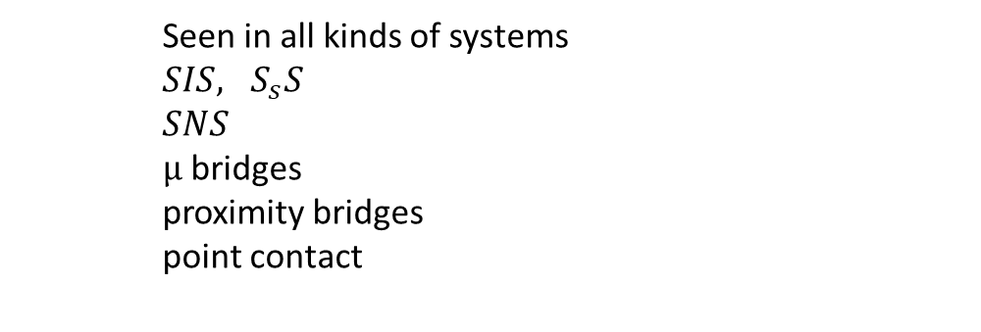
4 coupled differential equations $\dot{n_{L}},\dot{n_{R}}, \dot{θ_{L}}, \dot{θ_{R}}$
$$\dot{n_{L}}=−\dot{n_{R}}=\frac{2}{ℏ}K\sqrt{n_{L}n_{R}}\sin{θ}$$
$$\dot{θ}=\dot{θ_{L}}−\dot{θ_{R}}=\frac{2eV}{ℏ}$$
$$∆E\sim 2eV$$
Josephson supercurrent:
$$I=I_{c}\sin{θ}$$
$$\frac{ℏ }{2e}$$
$$ψ\sim e^{−i\left({∆E}/ℏ\right)t}=e^{−iωt}$$
Josephson relation: $V=$
$$\dot{θ}$$
This is Specific to tunnel junctions
Seen in all kinds of systems
$SIS, S_{s}S$
$SNS$
μ bridges
proximity bridges
point contact
(weak-coupled superconductors)

Slide 13
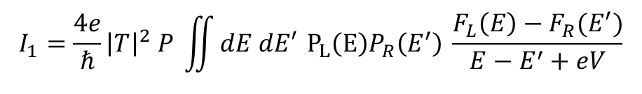
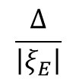
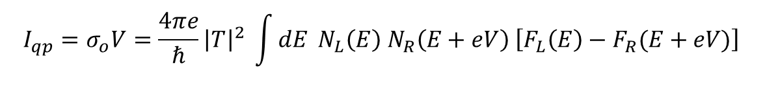
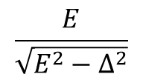

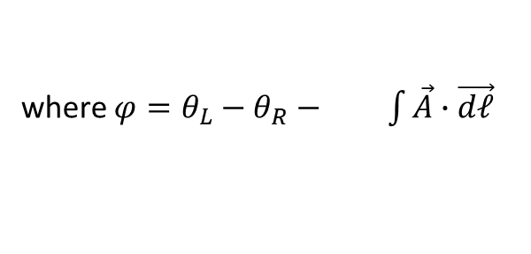
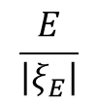




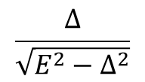
Josephson Tunneling
$$I\left(V, T, t\right)=σ_{o}\left(V, T\right)V+I_{1}\left(V,T\right)\sin{φ\left(t\right)}+σ_{1}\left(V, T\right)V\cos{φ(t)}$$
L
R
$$H=H_{L}+H_{R}+H_{T}$$
$$\frac{2e}{ℏ}$$
where $φ=θ_{L}−θ_{R}− \int{\vec{A}∙\vec{dℓ}}$
V
$$I_{qp}=σ_{o}V=\frac{4πe}{ℏ}{\left|T\right|}^{2} \int{dE} N_{L}\left(E\right) N_{R}\left(E+eV\right) \left[F_{L}\left(E\right)−F_{R}(E+eV)\right]$$
$$I_{1}=\frac{4e}{ℏ}{\left|T\right|}^{2} P \iint{dE dE′} P_{L}\left(E\right)P_{R}\left(E^{′}\right) \frac{F_{L}\left(E\right)−F_{R}(E^{′})}{E−E^{′}+eV}$$
$$\frac{E}{\left|ξ_{E}\right|}$$
$$\frac{E}{\sqrt{E^{2}−∆^{2}}}$$
$$\frac{∆}{\left|ξ_{E}\right|}$$
$$\frac{∆}{\sqrt{E^{2}−∆^{2}}}$$
$N\left(E\right)= =$
$$P\left(E\right)≡$$
$=$
“qp density of states”
“pair density of states”

Slide 14
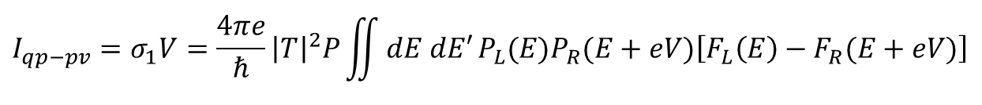
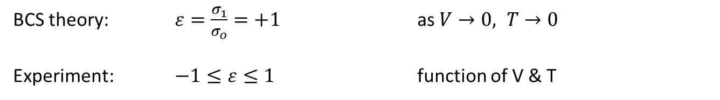
$$I_{qp−pv}=σ_{1}V=\frac{4πe}{ℏ}{\left|T\right|}^{2}P\iint{dE dE′}P_{L}(E)P_{R}(E+eV)\left[F_{L}\left(E\right)−F_{R}(E+eV)\right]$$
Cosϕ term
BCS theory: $ε=\frac{σ_{1}}{σ_{o}}=+1$ as $V→0, T→0$
Experiment: $−1≤ε≤1$ function of V & T
Not really understood – sensitive to model, tunneling details
ε
Maybe not very important but comes up periodically to try to explain something

Slide 15




Josephson theory
Explicitly get sinϕ, Josephson relation
Not specific to tunnel junctions ⟹ weak coupling SC
Cannot get cosϕ or T, V dependence of I (ignores qp’s)
Extensions:
Werthamer’s formula (frequency dependent voltages)
$$I\left(t\right)=I_{m}\left[e^{−\frac{1}{2}iφ(t)}\int_{−∞}^{t}{dt′}e^{1/2φ(t′)} j_{1}\left(t−t^{′}\right)\right.\left.+ e^{\frac{1}{2}iφ(t)}\int_{−∞}^{t}{dt′} e^{1/2φ(t)′} j_{2}(t−t^{′})\right]$$
normal current
supercurrent
$$H_{T}→ δψ→ I$$
$$I\left(V\right)=I_{m}{\tilde{j}}_{1}+\left(−R_{e}{\tilde{j}}_{2}(ω)\right)\sin{φ}+\left(I_{m}{\tilde{j}}_{2}\right)\cos{φ}$$
$$σ_{o}V$$
$$σ_{1}\left(V\right)V$$
$$I_{1}$$

Slide 16
$R_{e}{\tilde{j}}_{1}$ does not appear in Josephson original calculation
Most important in dealing with high frequency effects – biased beyond gap (parametric amplifiers)
Strong Josephson effects beyond the gap
Only works for insulator tunnel junctions
2. Josephson thermal Green’s function treatment
1st principles calculation
Can be generalized to any weak link

Slide 17
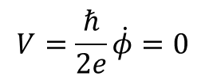

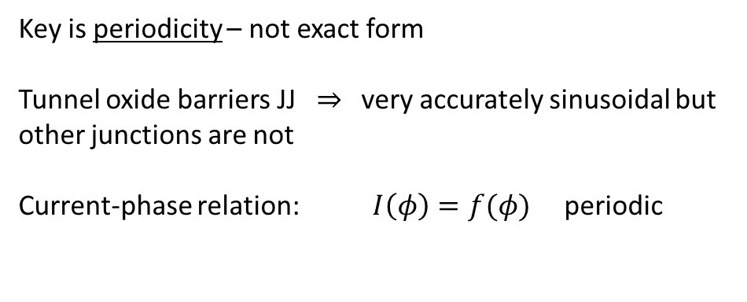
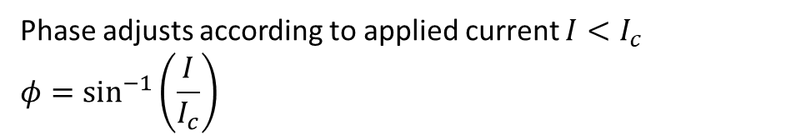


Supercurrent
Local: $J\left(x,y\right)=J_{c}\left(x,y\right)\sin{φ}\left(x,y\right)$
$$I=I_{c}\sin{φ}$$
DC:
$$V=\frac{ℏ}{2e}\dot{φ}=0$$
$φ=$ constant
Key is periodicity – not exact form
Tunnel oxide barriers JJ ⇒ very accurately sinusoidal but other junctions are not
Current-phase relation: $I\left(φ\right)=f(φ)$ periodic
Phase coherence extends across barrier
Current depends on phase, which is set by the external circuit
Phase adjusts according to applied current $I<I_{c}$
$$φ=\sin^{−1}\left(\frac{I}{I_{c}}\right)$$

Slide 18


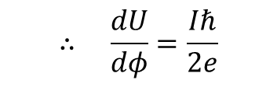
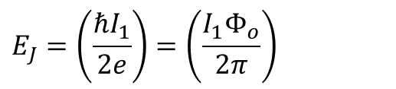





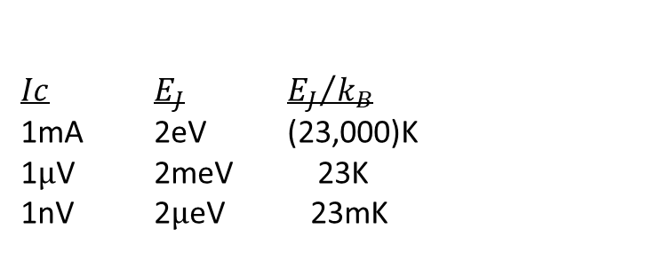




Josephson coupling energy :
Phase-coupling lowers energy
$$dU=IVdt$$
I
$$\frac{Iℏ}{2e}$$
= $\dot{φ}dt$
$$U$$
$$U$$
$$dφ$$
V
ϕ
$$∴ \frac{dU}{dφ}=\frac{Iℏ}{2e}$$
Bias current: $U\left(φ\right)=\frac{ℏ}{2e}Iφ$
I constant
Supercurrent: $dU=\frac{ℏI_{C}}{2e}\sin{φ}dφ$
I periodic in phase
$U\left(φ\right)=−\frac{ℏI_{c}}{2e}\cos{φ}$
assuming $U\left(\frac{π}{2}\right)=0$
$$T_{eff}=$$
$Ic$ $E_{J}$ ${E_{J}}/{k_{B}}$
1mA 2eV (23,000)K
1μV 2meV 23K
1nV 2μeV 23mK
$$=−E_{J}\cos{φ}$$
no supercurrent
$$E_{J}=\left(\frac{ℏI_{1}}{2e}\right)=\left(\frac{I_{1}Φ_{o}}{2π}\right)$$
Josephson coupling energy

Slide 19


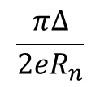



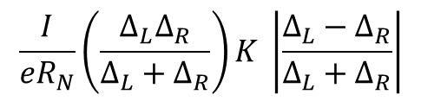






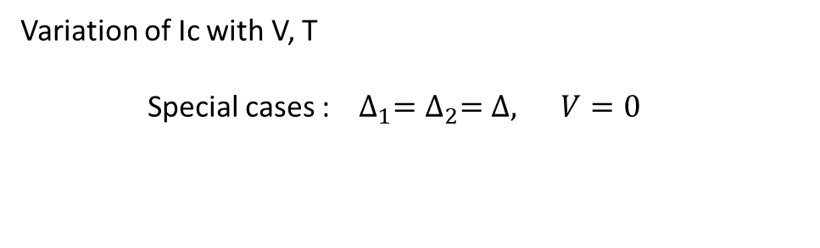


Variation of Ic with V, T
Special cases : ${ ∆}_{1}=∆_{2}=∆, V=0$
$$\frac{π∆}{2eR_{n}}$$
$$I$$
$$I_{c}=$$
same as jump in qp tunneling
$T>Tc$
$$T=0$$
$$2∆$$
$$V$$
$$\frac{I}{eR_{N}}\left(\frac{∆_{L}∆_{R}}{∆_{L}+∆_{R}}\right)K \left|\frac{∆_{L}−∆_{R}}{∆_{L}+∆_{R}}\right|$$
$∆_{L}≠∆_{R}$ $I_{c}\left(0\right)=$
$$I_{c}$$
0.5
$$Pb−Sn$$
$$T$$
$$I_{1}$$
0.75
$$∆_{Pb}=2∆_{Sn}$$
0.8
$$T_{c}$$
$$T$$
0.8

Slide 20



Strong – coupling: reduces Ic
Nb 75%
Pb 78%
Sn 91%
Al 100%
Magnetic impurities: reduces Ic
(similar to effect on N, affects P)
Pairbreaking by spin-flip scattering
In film, drops off roughly as Δ (order parameter)
$$1$$
Δ
$$I_{1}$$
$$E_{g}$$
α
gapless
In barrier, drop is dramatic!

Slide 21


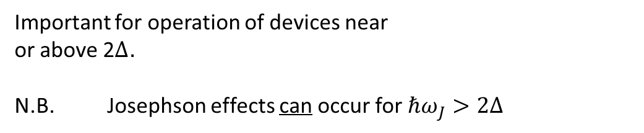

Voltage (frequency)
$$I_{1}(V)$$
$$2∆$$
$$eV$$
Riedel singularity – “resonance between qp and pair
tunneling”, intermediate states
highly probable
Important for operation of devices near
or above 2Δ.
N.B. Josephson effects can occur for $ℏω_{J}>2∆$

